Slide 1
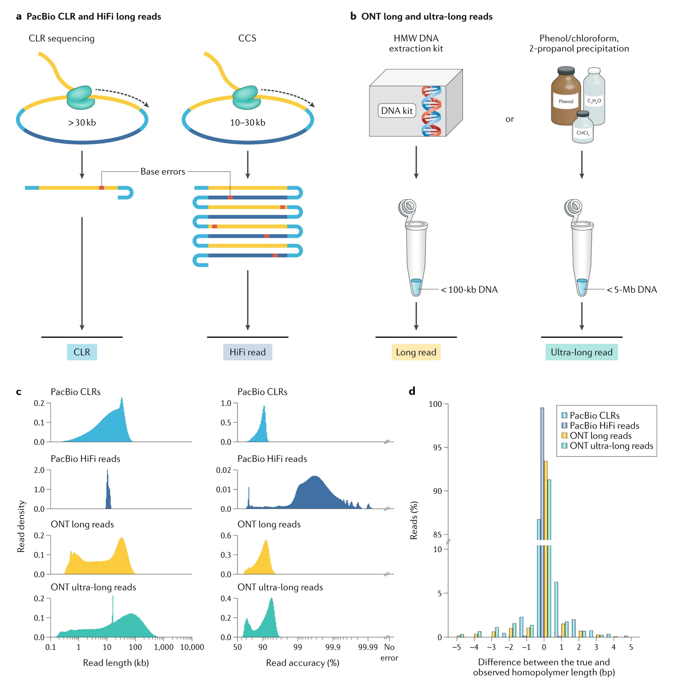
https://www.nature.com/articles/s41576-020-0236-x/figures/3

Slide 2
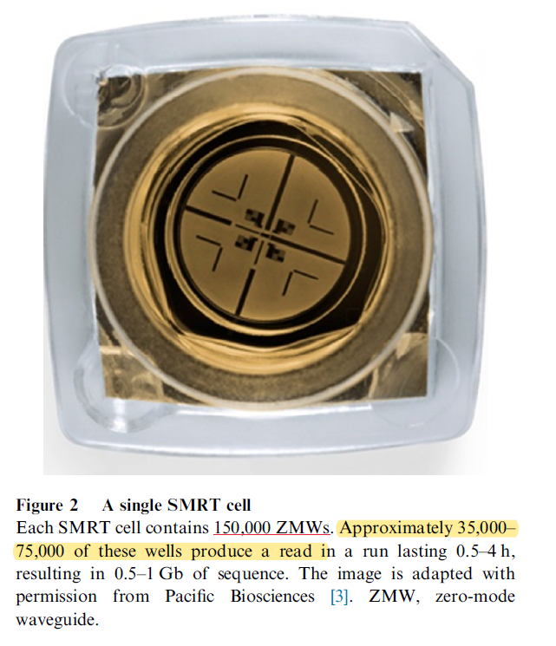
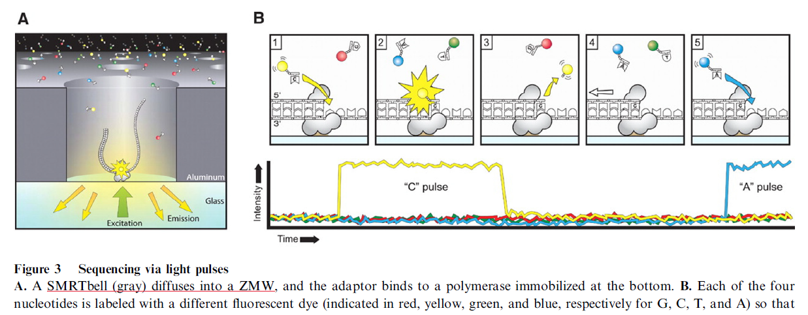
http://dx.doi.org/10.1016/j.gpb.2015.08.002

Slide 3
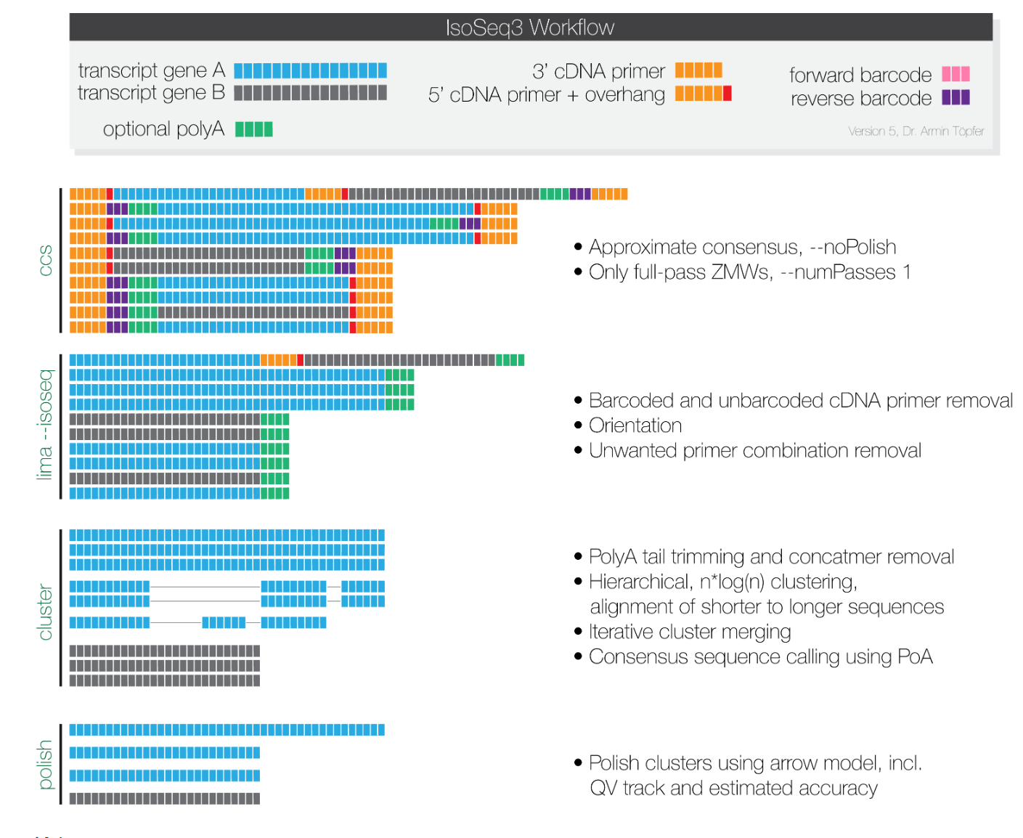
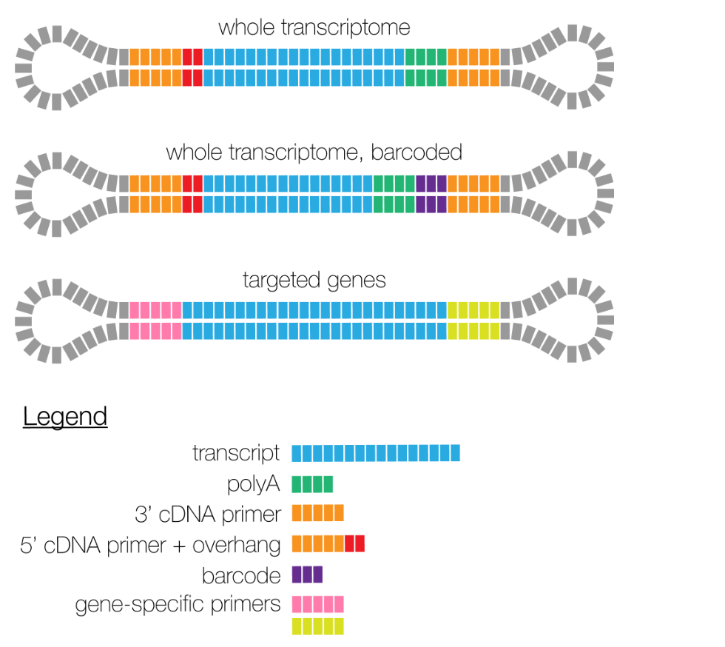
https://github.com/PacificBiosciences/IsoSeq

Slide 4
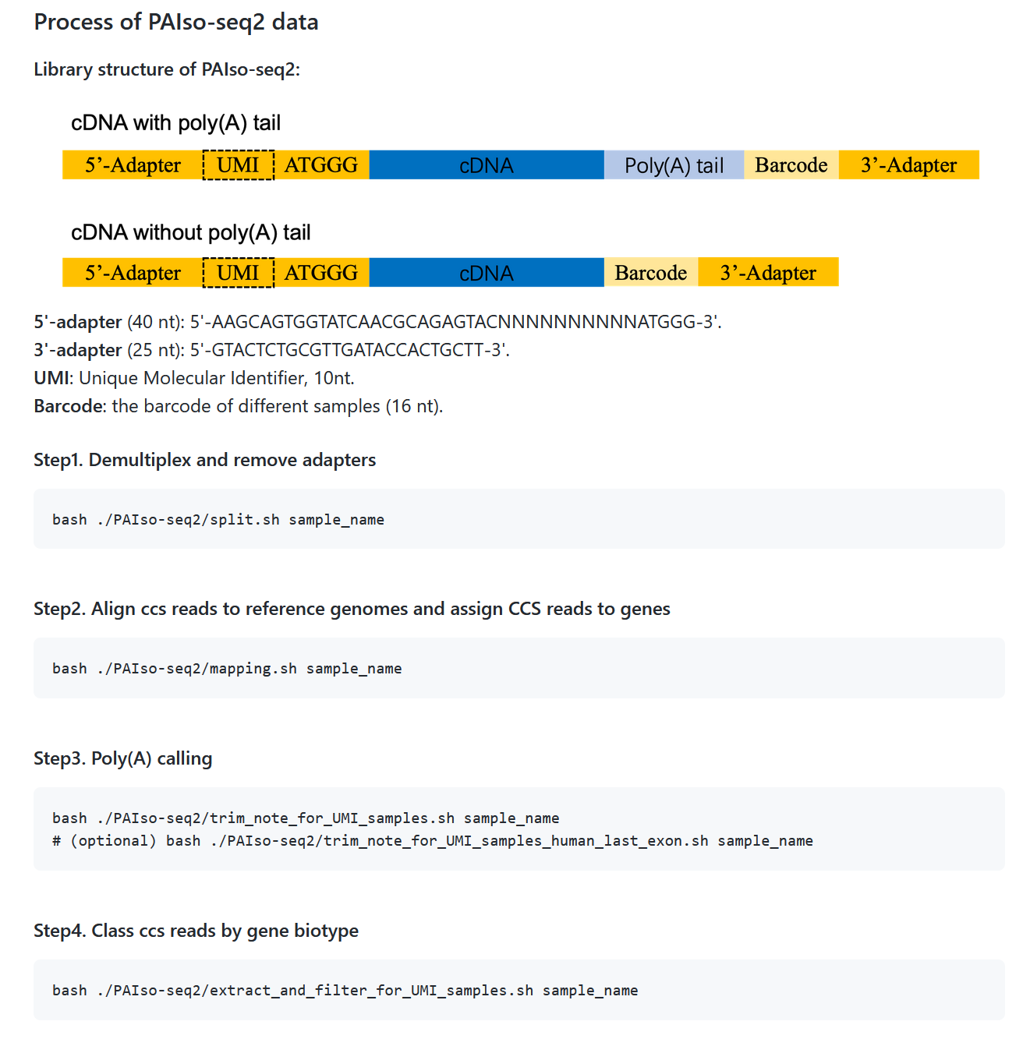
https://github.com/Lulab-IGDB/polyA_analysis

Slide 5
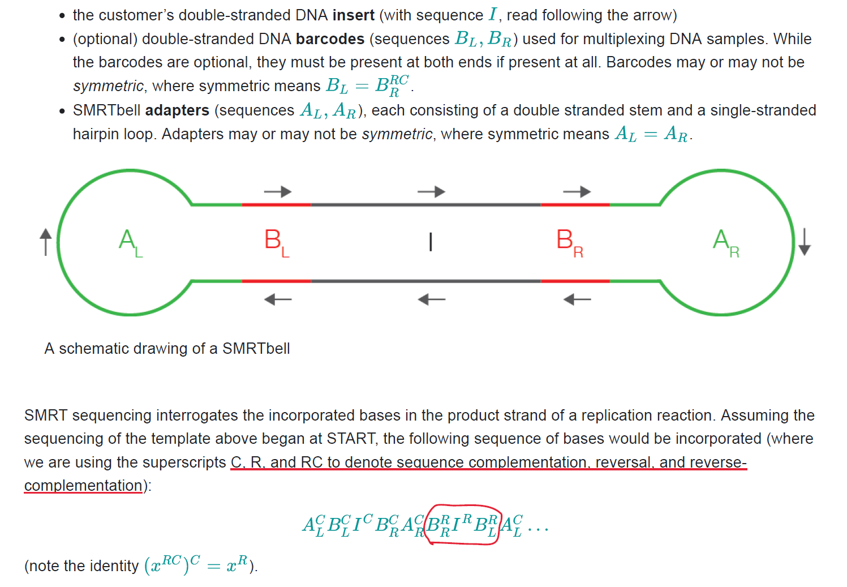
https://pacbiofileformats.readthedocs.io/en/10.0/Primer.html

Slide 6
